Slide 1
Restaurant Management System
Web Application

Slide 2
Group Members And Role
(19ucc114) Mohit Goyani (Frontend And Backend of Customer)
(19ucc141) Khushi Choudhary (Backend of Staff and Admin)
(19ucc124) Bhavya Patel (SQL Database and Some of the Java Classes)
(19ucc113) Karan Goyanka (SQL Database and Queries)

Slide 3
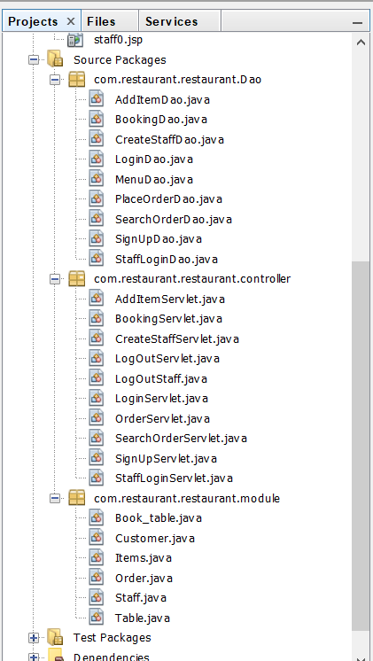
Classes Used
Customer
Book_Table (Extends Table)
Items
Order
Staff
Table
Other Servlets Files
And java files for Database access

Slide 4
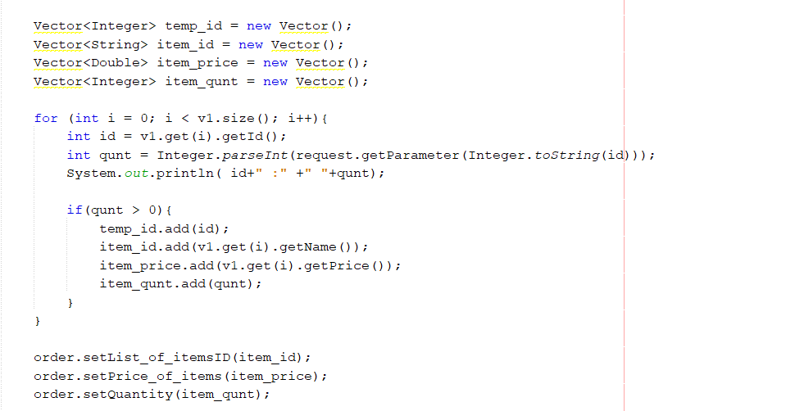
Collections used
Vectors

Slide 5
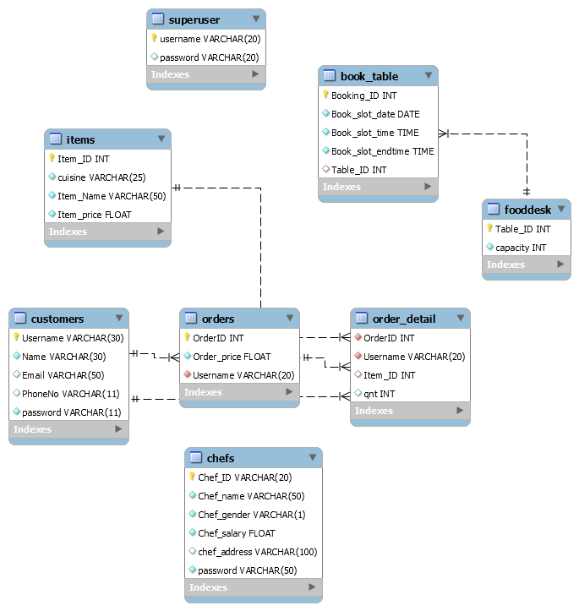
DataBase Schema
Superuser
Customer
Items
Orders
Order _detail
Foodesk (Table)
Chef (Staff)

Slide 6
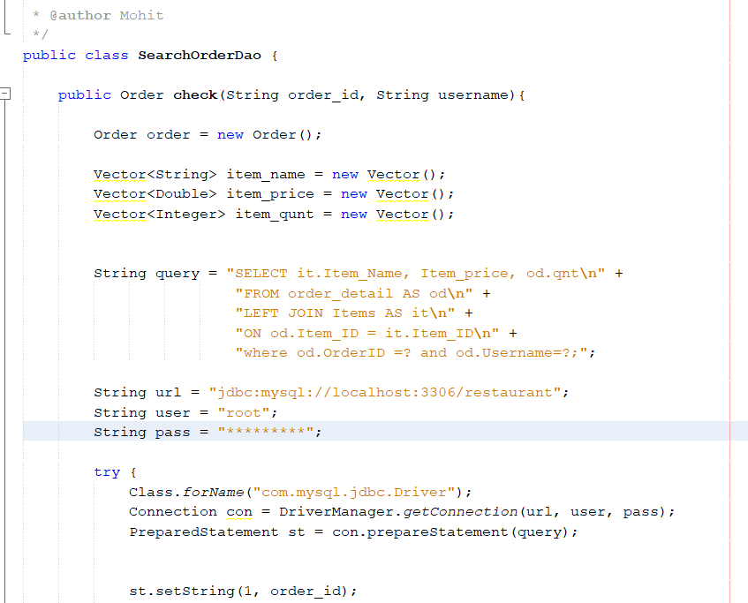
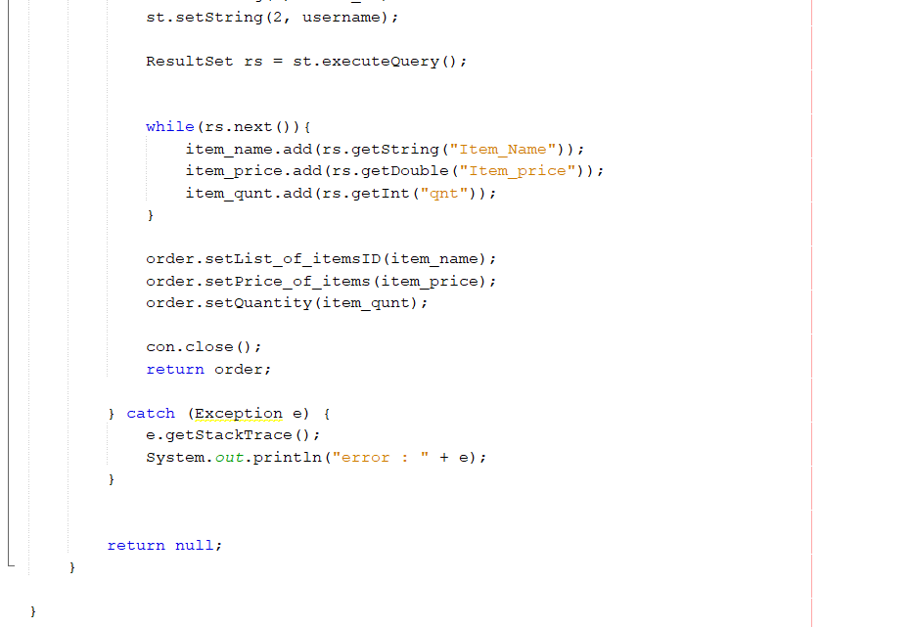
Database Connectivity
Used mysql-connector-java-8.0.16.jar for connectivity
All the java files in Dao package are used for Database Operations

Slide 7
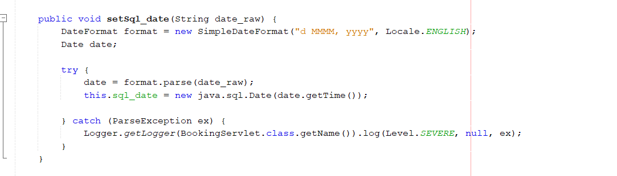
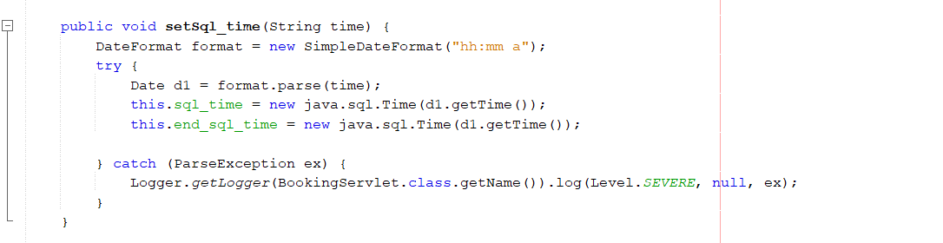
Java and Java.sql datetime

Slide 8
Exceptions
ParseException
ClassNotFoundException
NoSuchMethod
SQLException

Slide 9
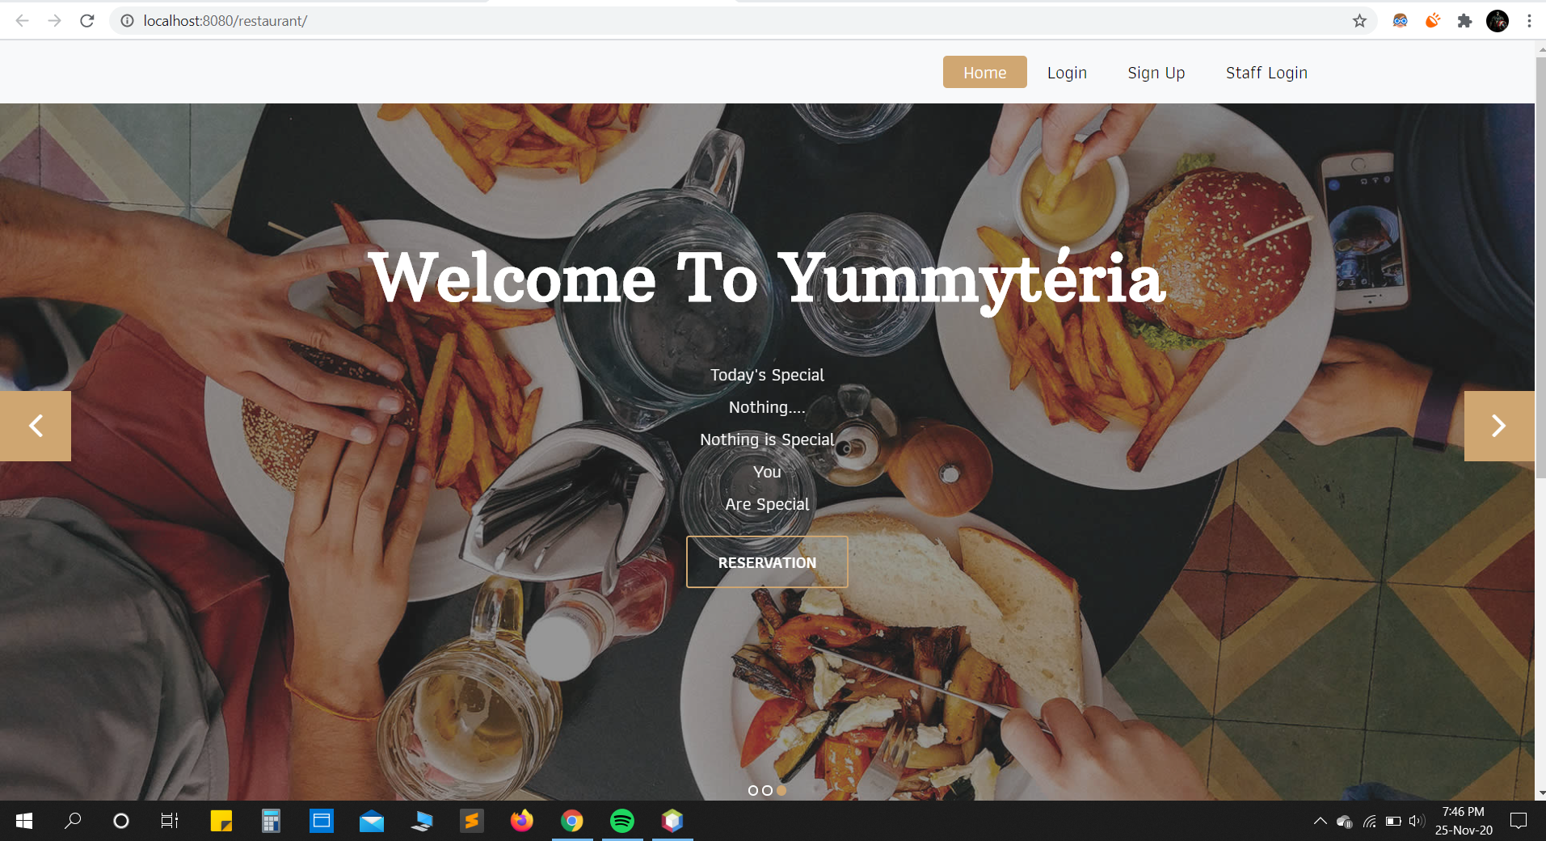
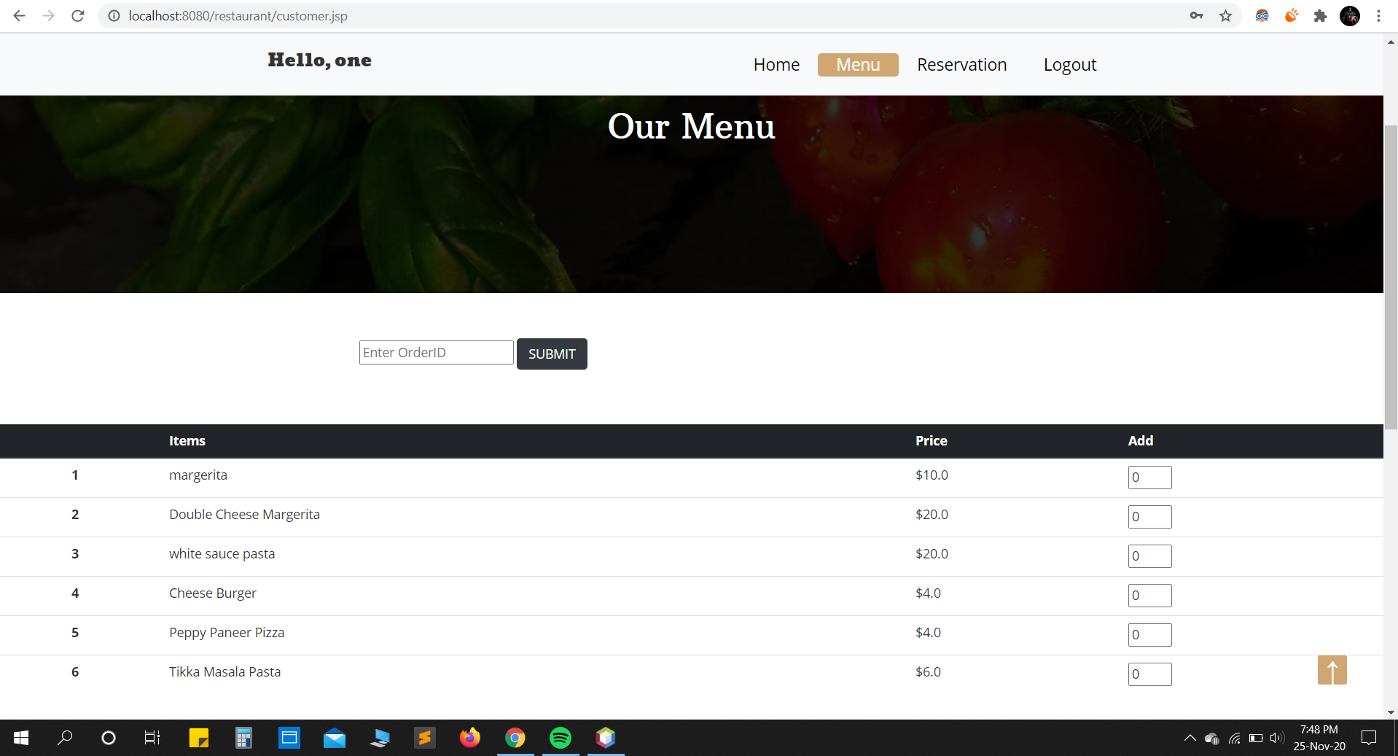
Some Snapshots of Complete Project

Slide 10
